Slide 1

Services Financials Report & Highlights
1
Services Financials Scorecard (Budget Achievement %)
Key Insight
5
Services Monthly Recurring Revenue Analysis
Key Insight
2
Services 1Q Performance & Key Highlights
Key Insight
6
Leading Indicators: CS & TS Bookings & Services ACV
Key Insight
3
Services FY19 Forecast & Key Highlights
Key Insight
7
Support Services YTD ACV Waterfall Analysis
Key Insight
4
1Q/FY19 Central Services Spending Highlights
Key Insight
8
Support Services Inclusion & Attach Rate (Next 90 days Leading Indicator)
Key Insight

Slide 2
Services GP for 2Q and Services GP excl. VBR insight
1
Services GP for 2Q
Services GP excl. VBR for 2Q
98% (+2% MoM)
93% (-2% MoM)
Budget Achievement | 1Q Forecast(%) | 2Q Forecast(%) | %Change (MoM) (July-June) | 3Q Forecast (%) | 4Q Forecast (%) | FY Forecast (%)
Service Revenue | 103 | 104 | 8 | 100 | 99 | 100
Service Rev (excl. VBR) | 97 | 98 | 0 | 99 | 99 | 99
Services GP | 98 | 95 | -3 | 99 | 99 | 98
Services GP (excl. VBR) | 93 | 93 | -1 | 99 | 99 | 97
Central Services * | 95 | 91 | 0 | 104 | 109 | 103
For Achieved Value color
For arrow color
GP : Gross Profit ($)
VBR : Vendor Business Resale ($)
Q : Quarter
FY : Financial Year
Central Services are mainly Overheads spending offset by GDCs/COEs recoveries
Arrow in the 1Q Forecast column indicates dip or growth w.r.t. previous month
Red, Amber, Green indicates Spend vs Budget comparison, since if spend is below budget or <100%, it will improve the bottom line profit & thus green
< 95%
Improved
95 <= x < 100%
Of concern
< 100%

Slide 3
Services Revenue for 2Q insight
2
Insight Description will come here.
fdg
1Q Services Revenue
103%
Services VBR
43%
M : Million Q: Quarters YoY: Year on Year Ach: Achievement Bgt: Budget PF : Prior Forecast
Improved
Warning
Of concern

Slide 4
Services (excl. VBR) and Support Services (excl. VBR) Revenue for Q2 insight
2
Services (excl. VBR) insight description.
M : Million
< Back
Next >
Financial Highlights | Q2 FY 2018 (M) | Q2 FY 2019 (M) | YoY% | Ach% | Bgt Gap (M) | Status (R/A/G) | PF Gap (M)
Total Revenue | 1871 | 1949 | 4.1% | 92% | -171 |  | -58
Product Revenue | 980 | 984 | 0.5% | 83% | -206 |  | -80
Services Revenue | 891 | 964 | 8.2% | 104% | 35 |  | 22
Services (excl. VBR) | 645 | 667 | 3.4% | 98% | -15 |  | -19
Support Services (excl. VBR) | 250 | 238 | -4.6% | 95% | -14 |  | -8
Managed Services (excl. VBR) | 192 | 212 | 10.4% | 99% | -3 |  | -6
Other Revenues (excl. VBR) | 10 | 9 | -13.5% | 96% | 0 |  | 1
Services VBR/Agency | 247 | 298 | 20.7% | 120% | 50 |  | 42
1Q Services Revenue
103%
DD Services
97%
Services VBR
43%
Service Revenue MoM
M : Million Q: Quarters YoY: Year on Year Ach: Achievement Bgt: Budget PF : Prior Forecast

Slide 5
DD Services Revenue 2Q insight
2
DD Services Revenue insight description
AM : America
MEA : Middle East & Africa
< Back
Next >
ad
DD Service Revenue
ygdgc
AM Region
ygdgc
MEA Region
ygdgc
M : Million Q: Quarters YoY: Year on Year Ach: Achievement Bgt: Budget PF : Prior Forecast

Slide 6
Support Services revenue insight
2
Support Services (excl. VBR) insight description
< Back
Next >
Lowest run rate
Support Services (excl. VBR) | Q2 FY 2018 (M) | Q2 FY 2019 (M) | YoY% | Ach% | Bgt Gap (M) | PF Gap (M)
Group Services | 249.8 | 238.3 | -4.6% | 95% | -13.6 | -7.6
Regions | 243.2 | 232.7 | -4.3% | 95% | -13.4 | -7.5
AM | 23.7 | 20.0 | -15.4% | 89% | -2.4 | -0.4
AP | 62.9 | 60.1 | -4.5% | 96% | -2.2 | -4.2
AU | 18.1 | 17.4 | -4.0% | 100% | 0.0 | 0.0
EU | 120.8 | 119.5 | -1.0% | 94% | -7.8 | -3.0
MEA | 17.8 | 15.8 | -11.2% | 95% | -0.9 | 0.0
Central Services | 6.6 | 5.6 | -15.0% | 95% | -0.3 | 0.0
SS (excl. VBR)
-5% YoY
Region Revenue
-3% to 17%
M : Million Q: Quarters YoY: Year on Year Ach: Achievement Bgt: Budget PF : Prior Forecast
VBR : Vendor Business Resale ($)

Slide 7
2Q Annuity Revenue insight
2
Annuity revenue insight description
< Back
Services Revenue (USD M) | May FY 19 (M) | Jun FY 19 (M) | Jul FY 19 (M) | Aug FY 19 (M) | Sep FY 19 (M) | MoM%
Services Revenue | 175.5 | 176.6 | 197.5 | 180.3 | 180.7 | 11.9%
Support Services (excl. VBR) | 84.3 | 82.8 | 103.7 | 89.6 | 89.4 | 25.2%
Managed Services (excl. VBR) | 91.2 | 93.7 | 93.8 | 90.8 | 91.3 | 0.1%
Annuity Revenue
+9M MoM
M : Million QoQ: Quarters on Quarter MoM: Month on Month

Slide 8
Services GP insight
2
Services GP insight description
Financial Highlights (USD 1M) | Q2 FY 2018 (M) | Q2 FY 2019 (M) | YoY% | Ach% | Bgt Gap (M) | Status (R/A/G) | PF Gap (M)
Total GP | 323 | 328 | 1.7% | 91% | -33 |  | -17
Product GP | 132 | 129 | -1.7% | 85% | -22 |  | -8
Services GP | 191 | 199 | 4.0% | 95% | -10 |  | -9
Services (excl. VBR) | 155 | 165 | 6.3% | 93% | -12 |  | -13
CS & TS Services (excl. VBR) | 41 | 46 | 11.5% | 93% | -3 |  | -8
Support Services (excl. VBR) | 75 | 75 | 1.2% | 96% | -3 |  | -4
Managed Services (excl. VBR) | 35 | 40 | 15.8% | 89% | -5 |  | -6
Other Revenue (excl. VBR) | 4 | 3 | -31.4% | 81% | -1 |  | 0
Services VBR/Agency | 36 | 34 | -5.8% | 105% | 2 |  | 4
1Q Services GP
98%
DD Services
93%
Services VBR
124%
Reason for slower pace, Click to know more
GP: Gross Profit($) M : Million Q: Quarters YoY: Year on Year Ach: Achievement Bgt: Budget PF : Prior Forecast

Slide 9
CS & TS GP insight
2
Insight description
DD : Dimension Data
VBR : Vendor Business Resale ($)
CS : Consulting Services
TS : Technical Services
< Back
Next >
Financial Highlights (USD 1M) | Q2 FY 2018 (M) | Q2 FY 2019 (M) | YoY% | Ach% | Bgt Gap (M) | Status (R/A/G) | PF Gap (M)
Total GP | 323 | 328 | 1.7% | 91% | -33 |  | -17
Product GP | 132 | 129 | -1.7% | 85% | -22 |  | -8
Services GP | 191 | 199 | 4% | 95% | -10 |  | -9
Services (excl. VBR) | 155 | 165 | 6.3% | 93% | -12 |  | -13
CS & TS Services (excl. VBR) | 41 | 46 | 11.5% | 93% | -3 |  | -8
Consulting Services (excl. VBR) | 11 | 14 | 22.8% | 80% | -4 |  | -1
Technical Services (excl. VBR) | 30 | 32 | 7.3% | 101% | 0 |  | -2
Support Services (excl. VBR) | 75 | 75 | 1.2% | 96% | -3 |  | -4
Managed Services (excl. VBR) | 35 | 40 | 15.8% | 89% | -5 |  | -6
Other Revenue (excl. VBR) | 4 | 3 | -31.4% | 81% | -1 |  | 0
Services VBR/Agency | 36 | 34 | -5.8% | 105% | 2 |  | 4
CS & TS GP
-3%
CS Services
-13%
M : Million Q: Quarters YoY: Year on Year Ach: Achievement Bgt: Budget PF : Prior Forecast

Slide 10
DD Core portfolios margins insight
2
Gross Margins of DD Services insight description
DD : Dimension Data
SS : Support Services
Financial Highlights (USD 1M) | Q2 FY 2018 (%) | Q2 FY 2019 (%) | YoY% | Ach% | Bgt Gap (%) | Status (R/A/G) | PF Gap (%)
Total GM | 17.3% | 16.9% | -0.4% |  | -0.2% |  | 0.4%
Product GM | 13.4% | 13.1% | -0.3% |  | -0.4% |  | 0.2%
Services GM | 21.5% | 20.6% | -0.8% |  | -1.9% |  | -1.4%
Services (excl. VBR) | 24.0% | 24.7% | -0.7% |  | -1.2% |  | -1.1%
Services VBR/Agency | 14.8% | 141.5% | -3.2% |  | -1.7% |  | -0.4%
Click to
know the Reason
GM of Services (excl. VBR)
-0.6%
Q: Quarters YoY: Year on Year Ach: Achievement Bgt: Budget PF : Prior Forecast

Slide 11
2
DD Core portfolios margins insight reason 1
Reason 1:
Description
CS : Consulting Services
TS : Technical Services
MS: Managed Services
< Back
Next >
Financial Highlights (USD 1M) | Q2 FY 2018 (%) | Q2 FY 2019 (%) | YoY% | Ach% | Bgt Gap (%) | Status (R/A/G) | PF Gap (%)
Total GM | 17.3% | 16.9% | -0.4% |  | -0.2% |  | 0.4%
Product GM | 13.4% | 13.1% | -0.3% |  | -0.4% |  | 0.2%
Services GM | 21.5% | 20.6% | -0.8% |  | -1.9% |  | -1.4%
Services (excl. VBR) | 24.0% | 24.7% | -0.7% |  | -1.2% |  | -1.1%
CS & TS Services (excl. VBR) | 21.5% | 22.3% | -0.1% |  | -1.9% |  | 0.1%
Support Services (excl. VBR) | 29.8% | 31.7% | 1.8% |  | 0.6% |  | -0.6%
Managed Services (excl. VBR) | 18.0% | 18.9% | 0.9% |  | -2.1% |  | -2.3%
Other Revenue (excl. VBR) | 42.6% | 33.8% | -8.8% |  | -6.3% |  | 2.1%
Services VBR/Agency | 14.8% | 11.5% | -3.2% |  | -1.7% |  | -0.4%
M : Million Q: Quarters YoY: Year on Year Ach: Achievement Bgt: Budget PF : Prior Forecast

Slide 12
2
DD Core portfolios margins insight reason 2
Reason 2:
Description
< Back
Next >
Services (excl. VBR) GM | Q2 FY 2018 | Q2 FY 2019 | YoY% | Ach% | Bgt Gap | PF Gap
Group Services | 22.6% | 21.8% | -0.8% |  | -1.5% | -4.0%
Regions | 22.8% | 21.7% | -1.0% |  | -1.5% | -3.6%
AM | 20.1% | 22.0% | 1.8% |  | -0.8% | -0.7%
AP | 23.6% | 20.4% | -3.1% |  | -3.2% | -9.2%
AU | 17.0% | 18.8% | 1.8% |  | 0.0% | -2.6%
EU | 21.8% | 22.0% | 0.2% |  | 0.0% | -2.4%
MEA | 29.1% | 26.1% | -3.0% |  | -2.5% | -1.6%
Central Services | 21.4% | 22.9% | 1.5% |  | -2.0% | -20.4%
Q: Quarters YoY: Year on Year Ach: Achievement Bgt: Budget PF : Prior Forecast

Slide 13
Product & Services Revenue and Margins insight
2
Services revenue and Product insight
Product & Services Revenue and Margins insights
Growth in Revenue
Services Margins
+4% YoY
-0.6% YoY
%
%

Slide 14
2Q Budget Achievements by Regions
2
Annotation will come here
Services Scorecard | Group | MEA | EU | AP | AU | AM | Central Services
Product Revenue | 84% | 95% | 92% | 101% | 100% | 58% | 102%
Services Revenue | 102% | 96% | 101% | 105% | 93% | 110% | 100%
Services GP | 93% | 87% | 98% | 89% | 99% | 92% | 94%
Services GM | -2.1% | -2.7% | -0.7% | -4.0% | 1.3% | -2.4% | -1.9%
1Q Services Revenue
103%
Services VBR
43%
M : Million Q: Quarters YoY: Year on Year Ach: Achievement Bgt: Budget PF : Prior Forecast
Improved
Warning
Of concern

Slide 15
2Q Budget Gaps by Regions
2
Annotation will come here
Services Scorecard | Group(M) | MEA(M) | EU(M) | AP(M) | AU(M) | AM(M) | Central Services(M)
Product Revenue | -186 | -4 | -24 | 21 | 0 | -180 | 0
Services Revenue | 26 | -7 | 4 | 13 | -8 | 24 | 0
Services GP | -20 | -7 | -1 | -7 | 0 | -3 | -2
Services GM | - | - | - | - | - | - | -
1Q Services Revenue
103%
Services VBR
43%
M : Million Q: Quarters YoY: Year on Year Ach: Achievement Bgt: Budget PF : Prior Forecast
Improved
Warning
Of concern

Slide 16
2Q YoY Growth (in %) by Regions
2
Annotation will come here
Services Scorecard | Group | MEA | EU | AP | AU | AM | Central Services
Product Revenue | 2.4% | 20.5% | -0.1% | 1.9% | 4.2% | 1.0% | 15.8%
Services Revenue | 7.8% | -0.4% | 10.2% | 1.3% | 2.5% | 18.8% | 12.1%
Services GP | -0.9% | -12.0% | 7.4% | -9.7% | 17.6% | 4.6% | 0.2%
Services GM | -1.9% | -3.4% | -0.6% | -2.7% | 2.8% | -1.8% | -3.4%
1Q Services Revenue
103%
Services VBR
43%
M : Million Q: Quarters YoY: Year on Year Ach: Achievement Bgt: Budget PF : Prior Forecast
Improved
Warning
Of concern

Slide 17
2Q YoY Growth in Millions by Regions
2
Annotation will come here
Services Scorecard | Group(M) | MEA(M) | EU(M) | AP(M) | AU(M) | AM(M) | Central Services(M)
Product Revenue | 24 | 12 | 6 | 5 | 5 | 2 | 0
Services Revenue | 91 | -1 | 29 | 3 | 3 | 44 | 12
Services GP | -2 | -6 | 5 | -6 | 3 | 2 | 0
Services GM | - | - | - | - | - | - | -
1Q Services Revenue
103%
Services VBR
43%
Improved
Warning
Of concern

Slide 18
FY19 Services Revenue
3
Annotation will come here
1Q Services Revenue
103%
Services VBR
43%
M : Million Q: Quarters YoY: Year on Year Ach: Achievement Bgt: Budget PF : Prior Forecast

Slide 19
FY19 Services GP
3
Annotation will come here
1Q Services Revenue
103%
Services VBR
43%
M : Million Q: Quarters YoY: Year on Year Ach: Achievement Bgt: Budget PF : Prior Forecast

Slide 20
FY19 Services Revenue excl. VBR
3
Annotation will come here
Financial Highlights (USD M) | Q1 FY 2019 (M) | Q2 FY 2019 (M) | Q3 FY 2019 (M) | Q4 FY 2019 (M) | FY19 (M) | YoY% | Ach% | Bgt Gap (M) | Status (R/A/G) | PF Gap (M)
Total Revenue | 1941 | 2254 | 2309 | 2490 | 8994 | 6.3% | 100% | -43 |  | 1226
Product Revenue | 989 | 1006 | 1086 | 1100 | 4182 | 6.7% | 97% | -121 |  | -16
Services Revenue | 951 | 1248 | 1223 | 1390 | 4812 | 6.0% | 102% | 78 |  | 1241
Services VBR/Agency | 247 | 305 | 208 | 298 | 1058 | 21.2% | 109% | 92 |  | 60
1Q Services Revenue
103%
Services VBR
43%
M : Million Q: Quarters YoY: Year on Year Ach: Achievement Bgt: Budget PF : Prior Forecast

Slide 21
FY19 Services Revenue excl. VBR (All 4Q’s Comparision)
3
Annotation will come here
< Back
Next >
Financial Highlights | Q1 FY 2019 (M) | Q2 FY 2019 (M) | Q3 FY 2019 (M) | Q4 FY 2019 (M) | FY 19 (M) | YoY% | Ach% | Bgt Gap (M) | Status (R/A/G) | PF Gap (M)
Total Revenue | 1941 | 2254 | 2309 | 2490 | 8994 | 6.3% | 100% | -43 |  | 1226
Product Revenue | 989 | 1006 | 1086 | 1100 | 4182 | 6.7% | 97% | -121 |  | -16
Services Revenue | 951 | 1248 | 1223 | 1390 | 4812 | 6.0% | 102% | 78 |  | 1241
Services (excl. VBR) | 704 | 942 | 1015 | 1092 | 3754 | 2.3 | 100% | -14 |  | 1182
Support Services (excl. VBR) | 232 | 284 | 295 | 321 | 1132 | 2.2 | 100% | -3 |  | 119
Managed Services (excl. VBR) | 165 | 247 | 292 | 316 | 1048 | 4.3 | 103% | 32 |  | 349
Other Revenues (excl. VBR) | 112 | 119 | 124 | 125 | 479 | 2.4 | 93% | -35 |  | 448
Services VBR/Agency | 247 | 305 | 208 | 298 | 1058 | 21.2% | 109% | 92 |  | 60
1Q Services Revenue
103%
Services VBR
43%
M : Million Q: Quarters YoY: Year on Year Ach: Achievement Bgt: Budget PF : Prior Forecast

Slide 22
FY19 Services Revenue excl. VBR (All 4Q’s Comparision Region wise)
3
Annotation will come here
< Back
Next >
Services (excl. VBR) | Q1 FY 19 (M) | Q2 FY 19 (M) | Q3 FY 19 M) | Q4 FY 19 (M) | FY19 (M) | Ach% | Bgt Gap (M) | PF Gap (M)
Group Services | 704 | 943 | 1015 | 1092 | 3754 | 100% | -14 | 1182
Regions | 689 | 834 | 896 | 964 | 3384 | 100% | -11 | 875
AM | 72 | 85 | 93 | 99 | 350 | 94% | -24 | 24
AP | 143 | 227 | 251 | 302 | 923 | 108% | 67 | 304
AU | 79 | 95 | 102 | 102 | 377 | 98% | -8 | 61
EU | 239 | 263 | 285 | 292 | 1079 | 99% | -13 | 46
MEA | 156 | 164 | 166 | 168 | 654 | 95% | -34 | 449
Central Services | 15 | 109 | 118 | 128 | 370 | 99% | -2 | 307
1Q Services Revenue
103%
Services VBR
43%
M : Million Q: Quarters YoY: Year on Year Ach: Achievement Bgt: Budget PF : Prior Forecast

Slide 23
FY19 Services GP excl. VBR
3
Annotation will come here
Financial Highlights (USD 1M) | Q1 FY 2019 (M) | Q2 FY 2019 (M) | Q3 FY 2019 (M) | Q4 FY 2019 (M) | FY 2019 (M) | YoY% | Ach% | Bgt Gap (M) | Status (R/A/G) | PF Gap (M)
Total GP | 334 | 395 | 437 | 490 | 1655 | 8.2% | 98% | -41 |  | 294
Product GP | 119 | 131 | 140 | 144 | 534 | 6.3% | 96% | -24 |  | -2
Services GP | 215 | 263 | 297 | 346 | 1121 | 9.2% | 98% | -17 |  | 296
Services (excl. VBR) | 174 | 224 | 263 | 293 | 954 | 8.3% | 97% | -29 |  | 265
CS & TS Services (excl. VBR) | 39 | 59 | 73 | 83 | 254 | 2.1% | 95% | -12 |  | 60
Support Services (excl. VBR) | 72 | 78 | 84 | 90 | 324 | 13.7% | 100% | 1 |  | -2
Managed Services (excl. VBR) | 35 | 56 | 70 | 81 | 242 | 12.8% | 100% | -1 |  | 82
Other Revenue (excl. VBR) | 28 | 31 | 36 | 39 | 134 | 1.0% | 89% | -17 |  | 125
Services VBR/Agency | 41 | 40 | 34 | 52 | 166 | 15.0% | 107% | 11 |  | 32
1Q Services Revenue
103%
Services VBR
43%
M : Million Q: Quarters YoY: Year on Year Ach: Achievement Bgt: Budget PF : Prior Forecast

Slide 24
FY19 Services GM excl. VBR
3
Annotation will come here
Financial Highlights (USD 1M) | Q1 FY 2019 (%) | Q2 FY 2019 (%) | Q3 FY 2019 (%) | Q4 FY 2019 (%) | FY 2019 (%) | YoY% | Ach% | Bgt Gap (%) | Status (R/A/G) | PF Gap (%)
Total GM | 17.2% | 17.5% | 18.9% | 19.7% | 18.4% | 0.3% |  | -0.4 |  | 0.9
Product GM | 12.0% | 13.1% | 12.8% | 13.1% | 12.8% | -0.1% |  | -0.2 |  | 0
Services GM | 22.6% | 21.1% | 24.3% | 24.9% | 23.3% | 0.7% |  | -0.7 |  | 0.2
Services (excl. VBR) | 24.7% | 23.7% | 26.0% | 26.8% | 25.4% | 1.4% |  | -0.7 |  | -1.4
Services VBR/Agency | 16.6% | 13.0% | 16.1% | 17.6% | 15.7% | -0.9% |  | -0.3 |  | 2.2
1Q Services Revenue
103%
Services VBR
43%
M : Million Q: Quarters YoY: Year on Year Ach: Achievement Bgt: Budget PF : Prior Forecast

Slide 25
2Q Central Services
4
Annotation will come here
 | Revenue |  | Gross Profit |  | Overheads |  | Operating Profit
Financial Highlights (USD M) | Q2 Actuals | Q2 Budget | Q2 Actuals | Q2 Budget | Q2 Actuals | Q2 Budget | Q2 Actuals | Q2 Budget
1Q Services Revenue
103%
Services VBR
43%
M : Million Q: Quarters YoY: Year on Year Ach: Achievement Bgt: Budget PF : Prior Forecast

Slide 26
FY19 Central Services
4
Annotation will come here
 | Revenue |  | Gross Profit |  | Overheads |  | Operating Profit
Financial Highlights (USD M) | FY19 Actuals | FY19 Budget | FY19 Actuals | FY19 Budget | FY19 Actuals | FY19 Budget | FY19 Actuals | FY19 Budget
1Q Services Revenue
103%
Services VBR
43%
M : Million Q: Quarters YoY: Year on Year Ach: Achievement Bgt: Budget PF : Prior Forecast

Slide 27
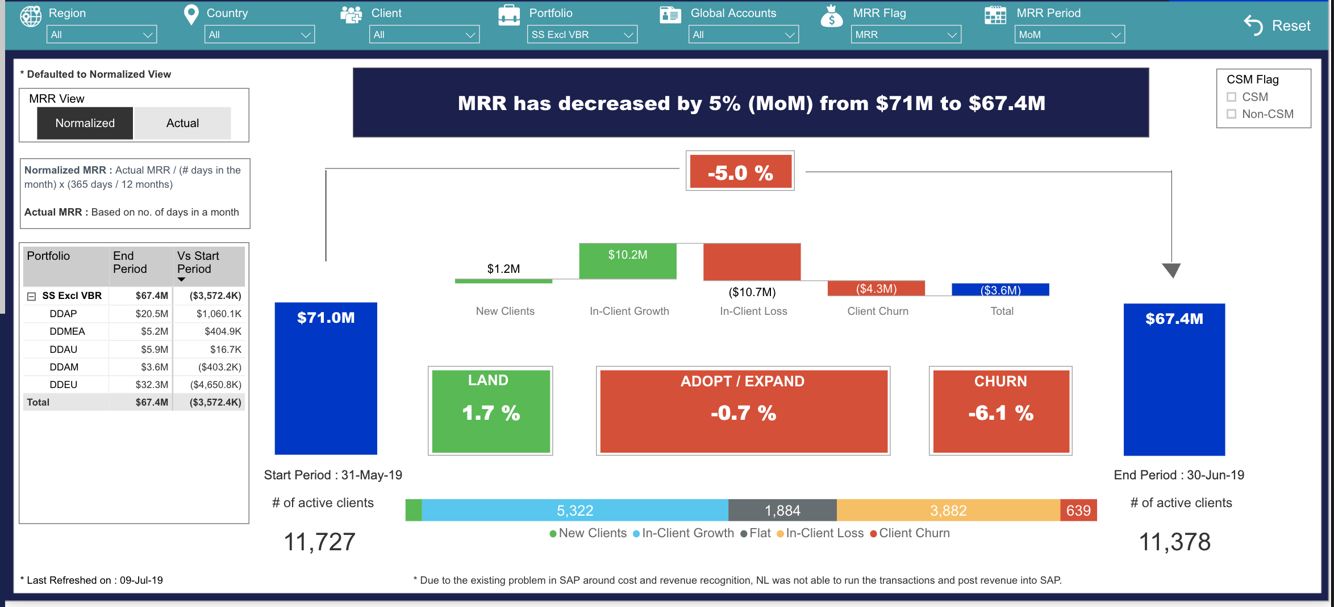
SS (excl. VBR) MRR (MoM)
5
Annotation will come here
1Q Services Revenue
103%
Services VBR
43%

Slide 28
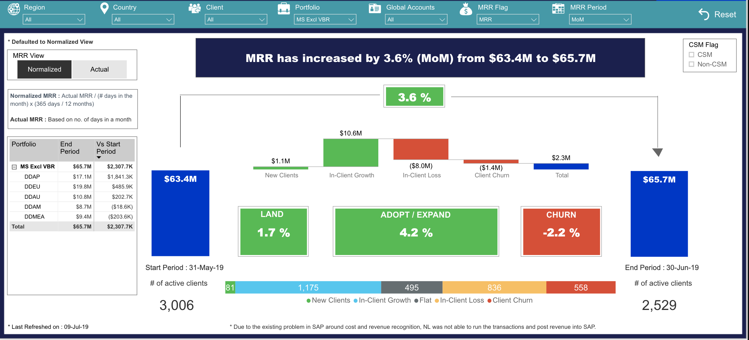
MS (excl. VBR) MRR (MoM)
5
Annotation will come here
1Q Services Revenue
103%
Services VBR
43%

Slide 29
Leading Indicators (1: Booking – Services and VBR comparision)
6
Annotation will come here
Order Booking Details (USD M) | Q2 FY 2018 (M) | Q2 FY 2019 (M) | YoY% | Ach% | Bgt Gap (%) | Status (R/A/G) | PF Gap (%)
Revenue
Product Booking | 994 | 1223 | 23.1% | 100 | 0 |  | 578
Services Booking (excl. VBR) | 576 | 647 | 12.3% | 101 | 9 |  | 233
VBR Booking | 211 | 248 | 17.9 | 100 | 0 |  | 51
1Q Services Revenue
103%
Services VBR
43%
M : Million Q: Quarters YoY: Year on Year Ach: Achievement Bgt: Budget PF : Prior Forecast

Slide 30
Leading Indicators ( 1: Booking - CS & TS insight or with other services comparison)
6
Annotation will come here
< Back
Next >
Order Booking Details (USD M) | Q2 FY 2018 (M) | Q2 FY 2019 (M) | YoY% | Ach% | Bgt Gap (%) | Status (R/A/G) | PF Gap (%)
Revenue
Product Booking | 994 | 1223 | 23.1% | 100 | 0 |  | 578
Services Booking (excl. VBR) | 576 | 647 | 12.3% | 101 | 9 |  | 233
CS & TS Services (excl. VBR) | 213 | 217 | 1.8% | 100 | 0 |  | 79
Support Services (excl. VBR) | 207 | 235 | 13.5% | 100 | 0 |  | 76
Managed Services (excl. VBR) | 145 | 192 | 32.6% | 105 | 9 |  | 79
Other Revenue (excl. VBR) | 11 | 3 | -72.3% | 100 | 0 |  | 0
VBR Booking | 211 | 248 | 17.9 | 100 | 0 |  | 51
1Q Services Revenue
103%
Services VBR
43%
M : Million Q: Quarters YoY: Year on Year Ach: Achievement Bgt: Budget PF : Prior Forecast

Slide 31
Leading Indicators (2: ACV - Services and VBR comparison)
6
Annotation will come here
Services ACV Details (USD M) | Q2 FY 2018 (M) | Q2 FY 2019 (M) | Ach% | YTD% | Bgt Gap (M) | PF Gap (M)
Services ACV | 3593 | 1210 | 65% | -65% | -647 | -10
Total MS ACV | 1467 | 598 | 73% | -61% | -219 | 2
MS ACV (excl. XaaS) | 1119 | 447 | 70% | -63% | -189 | 0
XaaS ACV | 349 | 152 | 83% | -54% | -30 | 2
Support ACV | 2126 | 612 | 59% | -69% | -427 | -12
1Q Services Revenue
103%
Services VBR
43%
M : Million Q: Quarters YoY: Year on Year Ach: Achievement Bgt: Budget PF : Prior Forecast

Slide 32
Leading Indicators (2: ACV – Region wise)
6
Annotation will come here
< Back
Next >
Services ACV | Q2 FY 2018 (M) | Q2 FY 2019 (M) | YTD% | Ach% | Gap (M) | PF Gap (M)
Group Services | 3592.9 | 1210.5 | -65.4% | 65.2% | -646.7 | -9.8
Regions | 3592.9 | 1210.5 | -65.4% | 65.2% | -646.7 | -9.8
AM | 441.1 | 182.2 | -52.5% | 80.1% | -45.4 | -0.3
AP | 857.2 | 0.0 | -100.0% | 0.0% | -444.1 | 0.0
AU | 445.8 | 226.7 | -49.4% | 100.0% | 0.0 | 1.6
EU | 1439.5 | 623.6 | -55.2% | 81.8% | -139.2 | -12.0
MEA | 409.4 | 177.9 | -54.8% | 90.8% | -18.0 | 0.9
1Q Services Revenue
103%
Services VBR
43%
M : Million Q: Quarters YoY: Year on Year Ach: Achievement Bgt: Budget PF : Prior Forecast

Slide 33
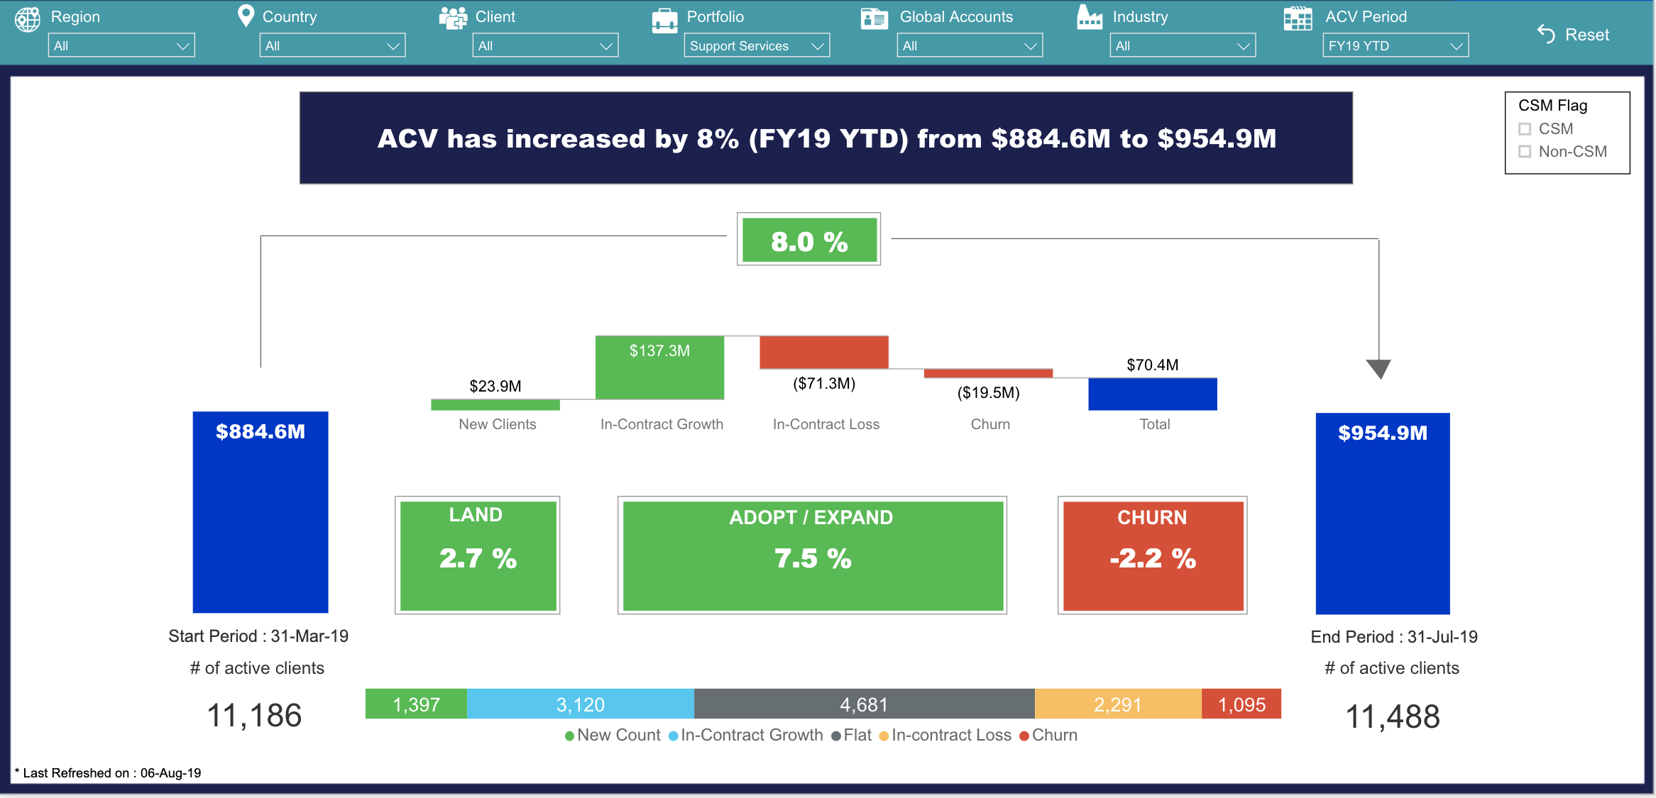
ACV Waterfall Analysis (SS FY19)
7
Annotation will come here
1Q Services Revenue
103%
Services VBR
43%

Slide 34
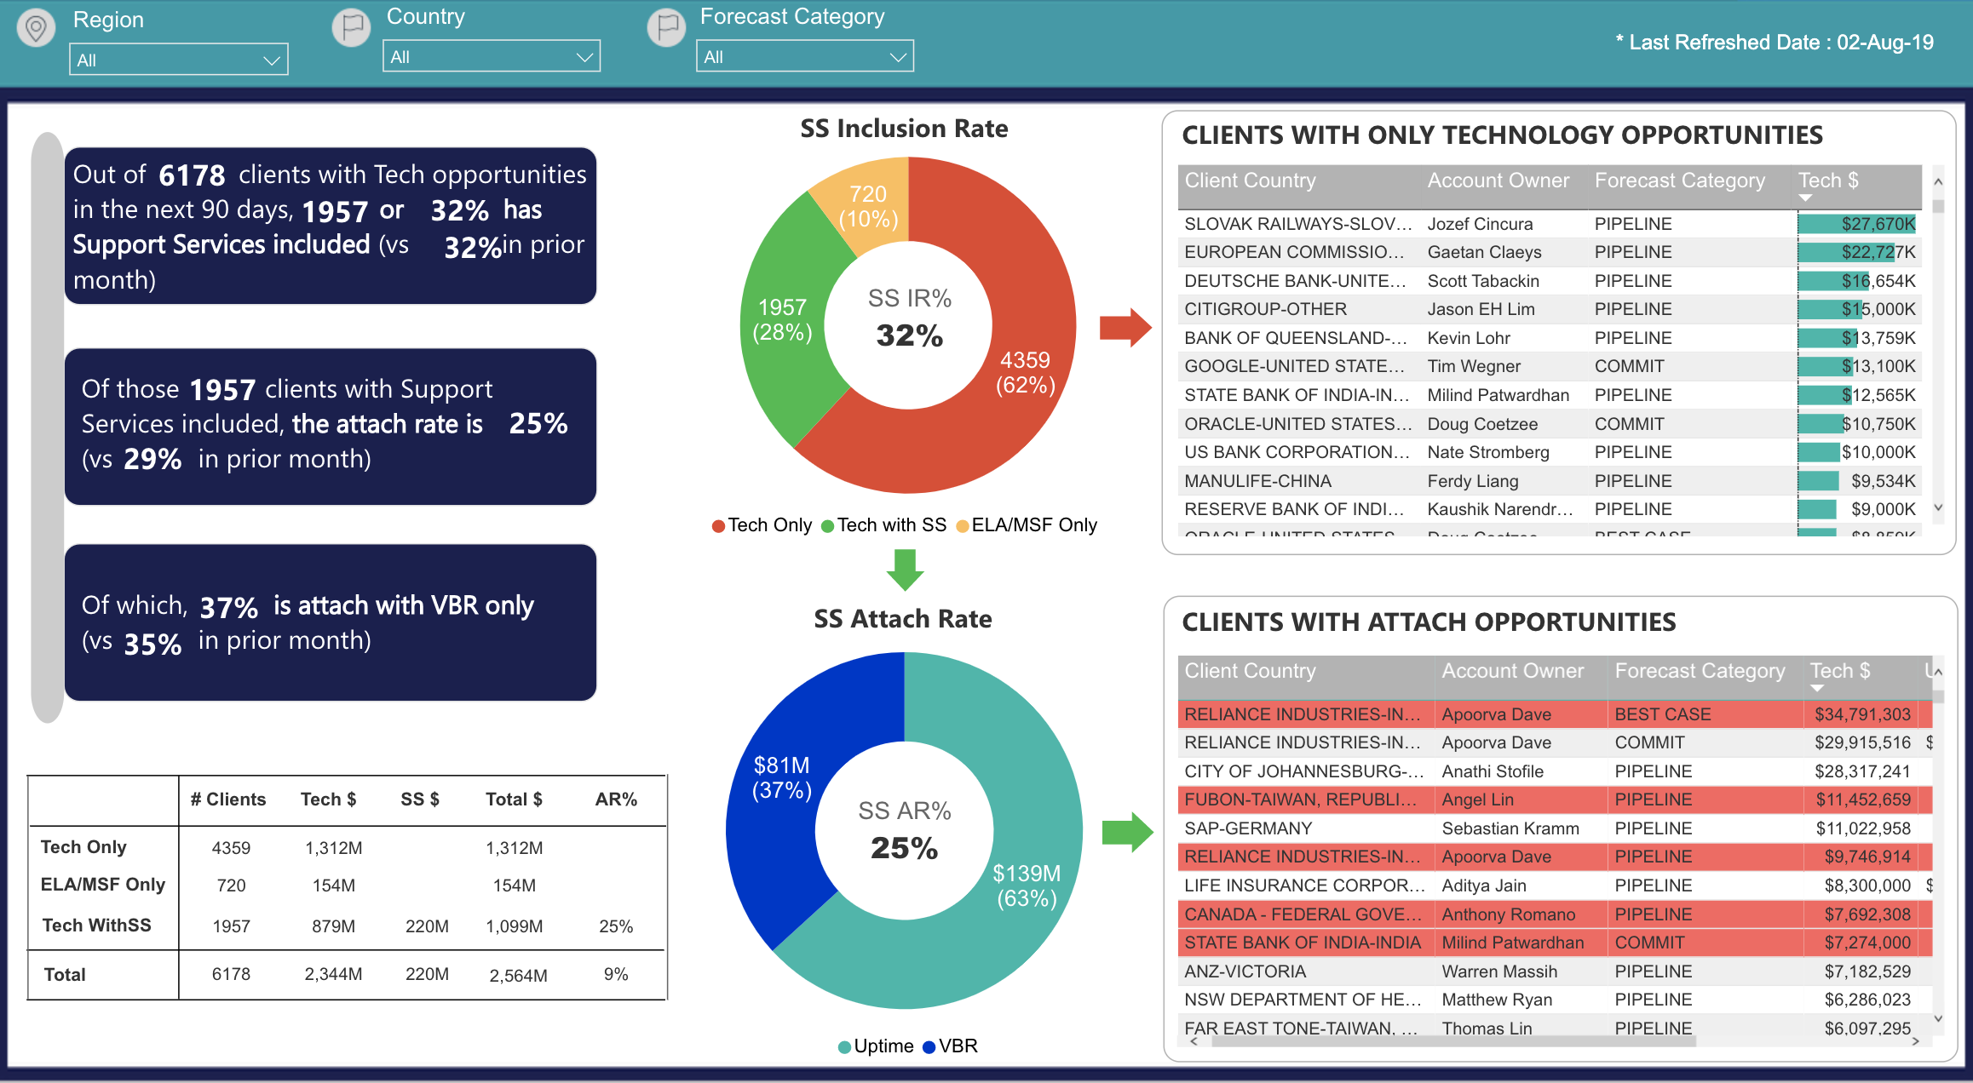
Support Service Inclusion Rate (IR) and Attached rate (AR)
8
Annotation will come here
1Q Services Revenue
103%
Services VBR
43%
M : Million Q: Quarters YoY: Year on Year Ach: Achievement Bgt: Budget PF : Prior Forecast

Slide 35
Backup
1Q Services Revenue
103%
Services VBR
43%
M : Million Q: Quarters YoY: Year on Year Ach: Achievement Bgt: Budget PF : Prior Forecast

Slide 36
SS MRR
8
Annotation will come here
1Q Services Revenue
103%
Services VBR
43%
M : Million Q: Quarters YoY: Year on Year Ach: Achievement Bgt: Budget PF : Prior Forecast

Slide 37
Support Services Actual Revenue
8
Services Revenue (USD M) | May FY 19 (M) | Jun FY 19 (M) | Jul FY 19 (M) | Aug FY 19 (M) | Sep FY 19 (M) | MoM%
Services Revenue | 175.5 | 176.6 | 197.5 | 180.3 | 180.7 | 11.9%
Support Services (excl. VBR) | 84.3 | 82.8 | 103.7 | 89.6 | 89.4 | 25.2%
Managed Services (excl. VBR) | 91.2 | 93.7 | 93.8 | 90.8 | 91.3 | 0.1%
Annotation will come here
1Q Services Revenue
103%
Services MRR (USD M) | May FY 19 (M) | Jun FY 19 (M) | Jul FY 19 (M) | Aug FY 19 (M) | Sep FY 19 (M) | MoM%
Services MRR | 251.1 | 248.6 | -313.0 |  |  | -225.9%
Support Services (excl. VBR) | 74.9 | 69.2 | -8.0 |  |  | -111.6%
Managed Services (excl. VBR) | 176.1 | 179.4 | -304.9 |  |  | -270.0%
Services VBR
43%
M : Million Q: Quarters YoY: Year on Year Ach: Achievement Bgt: Budget PF : Prior Forecast

Slide 38
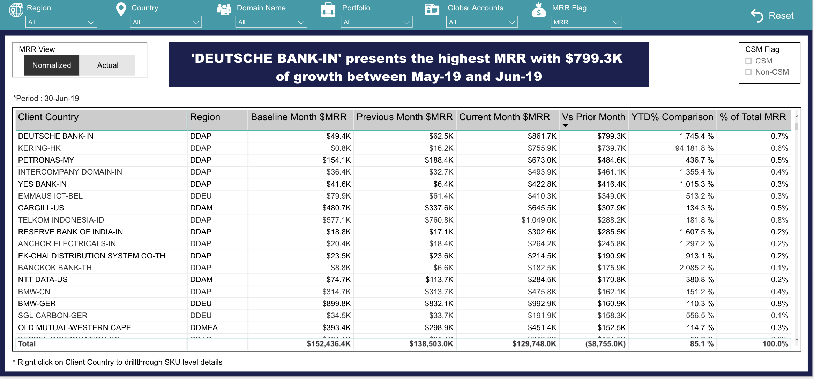
Support Services Actual Revenue (Client related Insights)
8
Annotation will come here
1Q Services Revenue
103%
Services VBR
43%
M : Million Q: Quarters YoY: Year on Year Ach: Achievement Bgt: Budget PF : Prior Forecast

Slide 39
MS MRR increase driven by
8
Annotation will come here
1Q Services Revenue
103%
Services VBR
43%
M : Million Q: Quarters YoY: Year on Year Ach: Achievement Bgt: Budget PF : Prior Forecast

Slide 40
Managed services Actual Revenue
Services Revenue (USD M) | May FY 19 (M) | Jun FY 19 (M) | Jul FY 19 (M) | Aug FY 19 (M) | Sep FY 19 (M) | MoM%
Services Revenue | 175.5 | 176.6 | 197.5 | 180.3 | 180.7 | 11.9%
Support Services (excl. VBR) | 84.3 | 82.8 | 103.7 | 89.6 | 89.4 | 25.2%
Managed Services (excl. VBR) | 91.2 | 93.7 | 93.8 | 90.8 | 91.3 | 0.1%
Annotation will come here
1Q Services Revenue
103%
Services MRR (USD M) | May FY 19 (M) | Jun FY 19 (M) | Jul FY 19 (M) | Aug FY 19 (M) | Sep FY 19 (M) | MoM%
Services MRR | 251.1 | 248.6 | -313.0 |  |  | -225.9%
Support Services (excl. VBR) | 74.9 | 69.2 | -8.0 |  |  | -111.6%
Managed Services (excl. VBR) | 176.1 | 179.4 | -304.9 |  |  | -270.0%
Services VBR
43%
M : Million Q: Quarters YoY: Year on Year Ach: Achievement Bgt: Budget PF : Prior Forecast

Slide 41
Managed services Actual Revenue (Client Related Insights)
Annotation will come here
1Q Services Revenue
103%
Services VBR
43%

